Slide 1
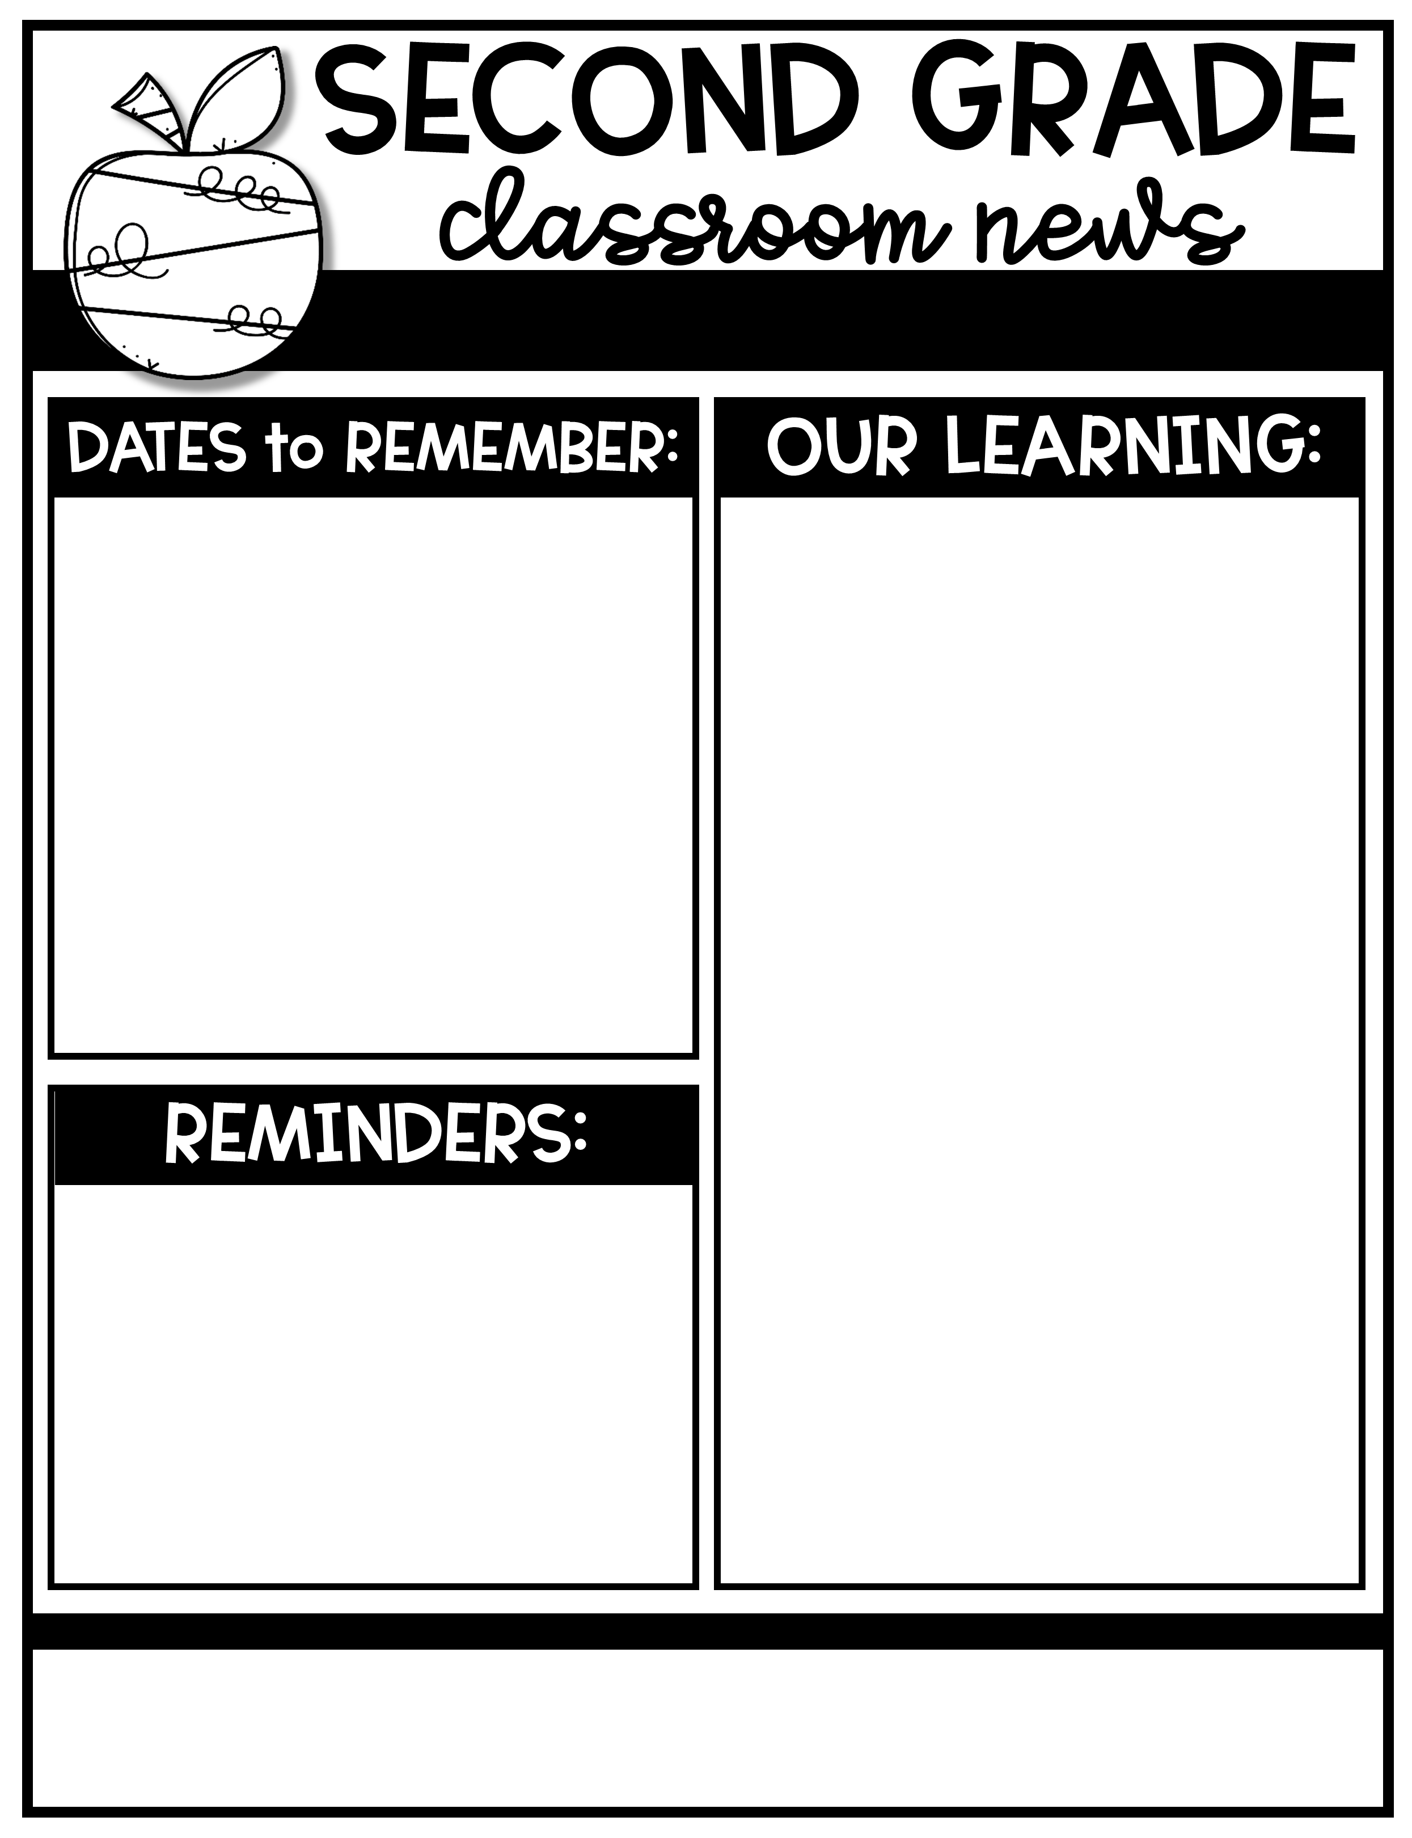
Ms. Tompkins’ Newsletter August 15-19, 2022
August 18th | Back to School Night!
August 26th | PBIS Kickoff
September 5th | LABOR DAY! NO SCHOOL!
September 13th | PTO Meeting
Skills for the week 2: Reading- Ask and answer questions: who what where when how and why. Main topic and key details Language- simple sentences-capitalization and punctuation Phonics- Magic e words (1_e, u_e) Writing- Narrative Baseline Math- adding and subtracting within 10 Social Studies- Citizenship/community
Word Wall Words- Silent e (long vowel)
Week 2
June
tube
rude
tune
rule
cube
fire
wire
tire
hire
RED WORD- sure
Please send back all forms ASAP!
Pay on “MySchoolBucks” on Madison county website
PTO Fee $10
Supply Fee $40
Chrome Book Fee $25
Your child can bring a sweater to class. Our Classroom sometimes gets cool!
Wear tennis shoes on PE day (Tuesday)
Sign your child’s BLUE Take Home Folder every day.
Make sure to send a pair of headphones/earphones.
Ann Smith Elementary
601-856-6621
atompkins@Madison-schools.com
Theme: “You‘ve got a friend in ME!”
Character Trait: RESPONSIBILITY

